Slide 1
Archaeology
Year 7 HASS

Slide 2
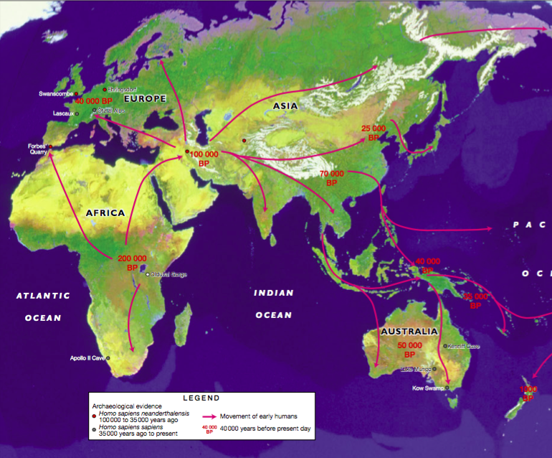
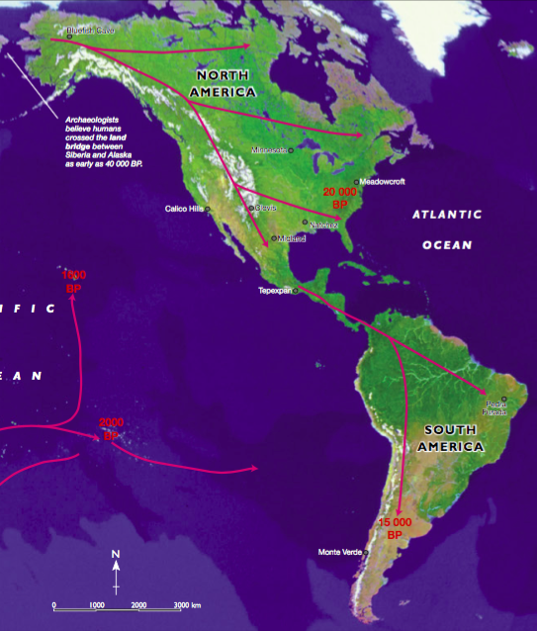
The First Humans
Modern humans have existed on Earth for about 200 000 years.

Slide 3
https://www.youtube.com/watch?v=IAQAAJo1fI0&feature=youtu.be

Slide 4

Do Now: Historians
A __________ is someone that tries to understand and explain the past by examining its remains. For example, they examine _______, bones, books and ruins. These are also known as _______.
Some sources are easier to find than others. Some groups of people from the past have left behind more _______ sources than others.
Regardless of whether the source is a small fragment of ancient pottery or a detailed book, it will only represent a small piece of the _________ or one person’s_________. Therefore, historians need to research widely and understand that there are some periods in history for which we cannot gather evidence.
They also work with experts in other fields- such as scientists, biologists, translators, palaeontologists, geologists and ________- to construct a more accurate and complete picture of the ________.
Primary Puzzle Perspective
Past Archaeologists Sources
Historian Fossils

Slide 5
Historians
A historian is someone that tries to understand and explain the past by examining its remains. For example, they examine fossils, bones, books and ruins. There are also known as sources.
Some sources are easier to find than others. Some groups of people from the past have left behind more primary sources than others.
Regardless of whether the source is a small fragment of ancient pottery or a detailed book, it will only represent a small piece of the puzzle or one person’s perspective. Therefore, historians need to research widely and understand that there are some periods in history for which we cannot gather evidence.
They also work with experts in other fields- such as scientists, biologists, translators, palaeontologists, geologists and archaeologists- to construct a more accurate and complete picture of the past.

Slide 6
Historians
Historians study history by looking at documental evidence (such as maps, diaries, carvings, photographs, interviews).
But, cannot rely on one source of evidence to understand what happened in the past. They need other ‘experts’ to help them.
Some of these experts are:
Biologists, geneticists, paleontologists and archaeologists.

Slide 7
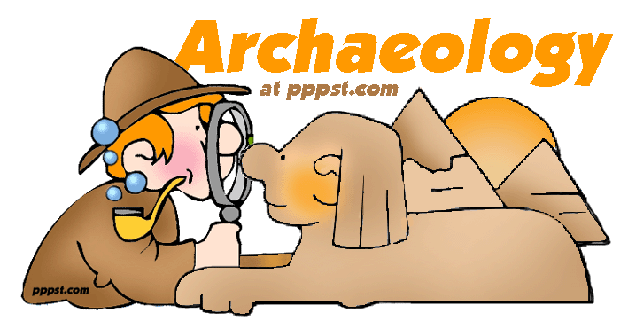
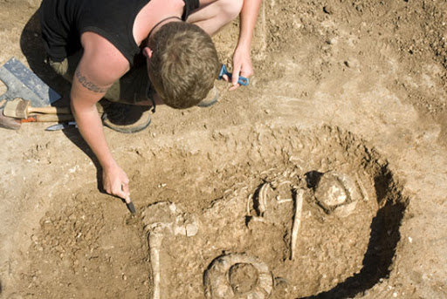
Archaeologists
Archaeologists study human history by examining physical remains. They help historians to reconstruct the past.
For example:
-Ruins of towns, temples and tombs
-Artefacts such as pottery, weapons, tools, coins
-Inscriptions and carvings
-Rubbish dumps and fire sites

Slide 8
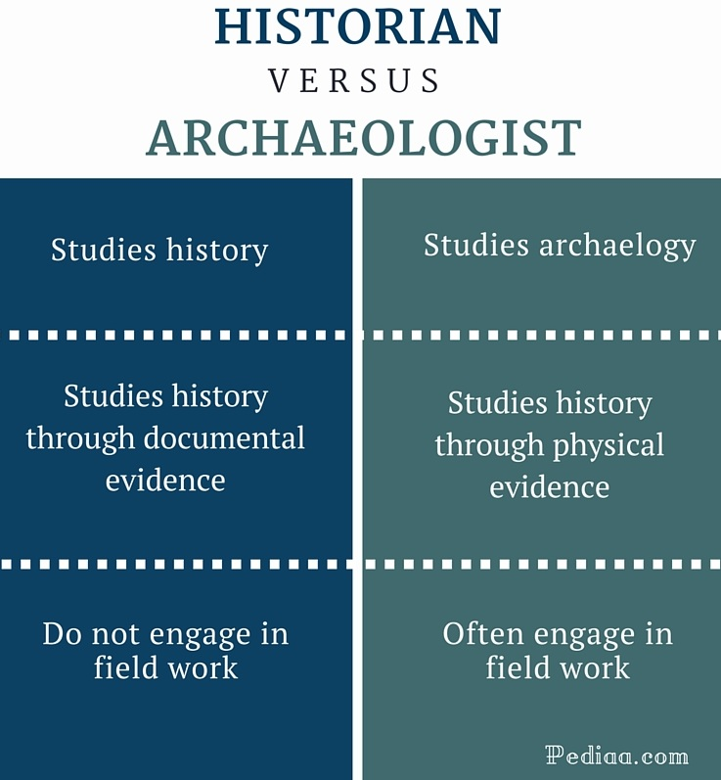

Slide 9
Working together – Tutankhamen’s Tomb
The Historian
Stelas (stone tablets/ monuments)
Tomb inscriptions
Inscriptions on statues
Official documents
Writings on burial goods
The Archaeologist
Tombs in the Valley of the Kings
Burial goods
Mummified body
Wall paintings
Temples
Notes:
https://www.youtube.com/watch?v=Avqafc6fZwc

Slide 10
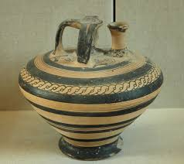
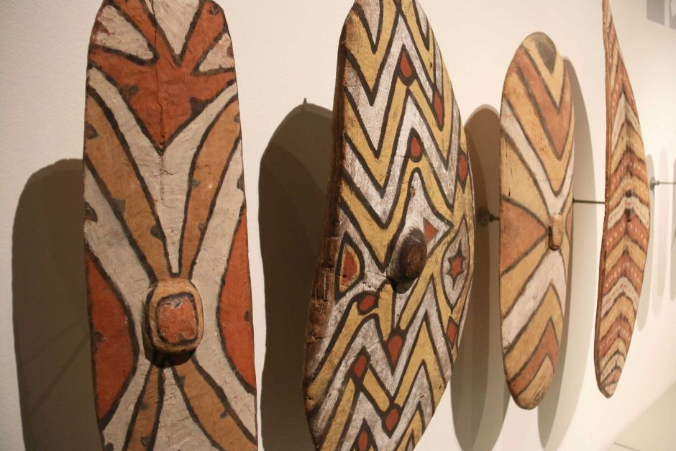
What is an artefact?
An object that is made or changed by humans.
E.g. a tool, remains of a building
Can you think of any other artefacts?

Slide 11
Archaeologists find and put together the clues to learn out about our ancestors.
Using the evidence, we can discover many things including:
-When humans came to an area.
-How they lived.
-How long they lived.
-Their lifestyle, food, diseases and many other things about our ancestors.
This is difficult! Some sources are so old that they have turned into fossils or remain only as a ‘shadow’ in the soil. Some archaeologists also work underwater.

Slide 12
Most sources found on land are buried
Floods
Wind blows sand
Covered by forests

Slide 13
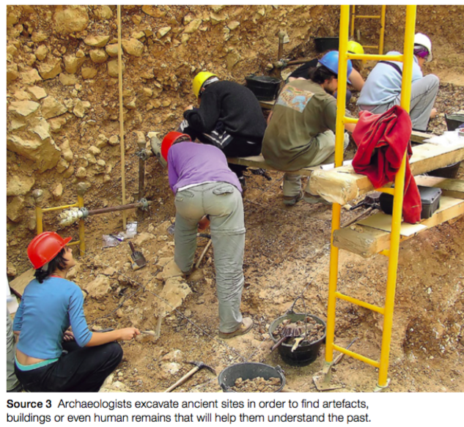
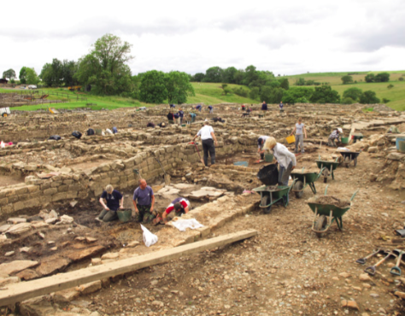
Archaeological Digs https://www.youtube.com/watch?v=-etaxcuJSyo Once a site is discovered, archaeologists set up a ‘dig’.

Slide 14
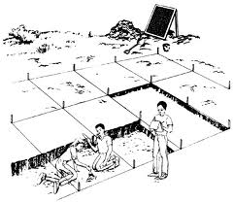
BOX GRID SYSTEM

Slide 15
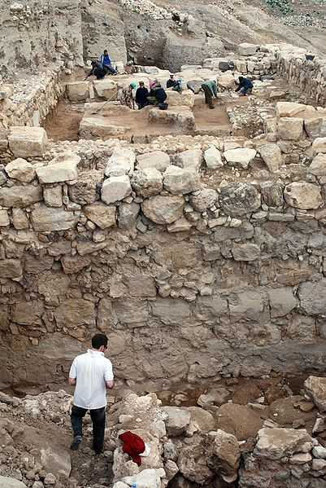
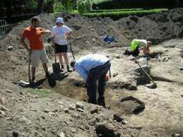
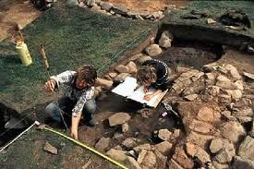
Archaeologists at work
Notice the grid system.
What tools are the archaeologists using?
Unfortunately, even the act of digging destroys evidence!
Notes:
Diagram on right: A view to the east showing work in the Migdol Temple precinct during 2007. In the foreground a large multi-roomed Iron Age (ca. 900 BC) complex is being excavated, while in the background, work is being undertaken to investigate deposits beneath the Middle Bronze Age temple structure (>1650 BC). Note the massive west exterior wall of the Migdol Temple seen in this image.

Slide 16
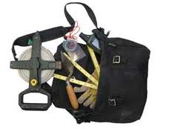
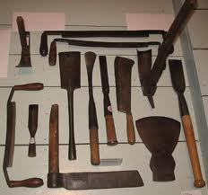
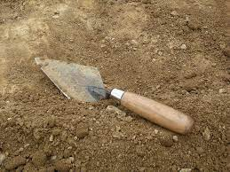
Tools of the trade
A trowel is essential but archaeologists use a wide range of tools and equipment from bulldozers to cotton gloves.

Slide 17
Destruction of evidence
War
Tomb robbers and looters have taken and destroyed much evidence.
Pollution in the modern age is destroying many ancient monuments and sites. Smog has been destroying stonework in Athens. Sewerage in Egypt has caused problems to its ancient monuments.
Tourism – e.g., brown bacterial growth on the walls of Tutankhamen’s tomb caused by the 25 litres of human sweat that condense there every day.
Plants, rat, mice, insects, fungi and bacteria can all degrade a site.

Slide 18
https://www.youtube.com/watch?v=cnMa-Sm9H4k
Machu Picchu- World famous archaeological site

Slide 19
We can tell how long ago humans came to an area by finding the clues they left behind and using different scientific methods to date these clues.
What examples of possible clues can you think of?

Slide 20
Possible clues include…
Tools, weapons and jewellery.
Buildings/shelters.
Pottery
Graves (human remains and burial goods).
Artworks.
Footprints that have been preserved.
Ancient rubbish piles
There are also many more clues archaeologists use.

Slide 21
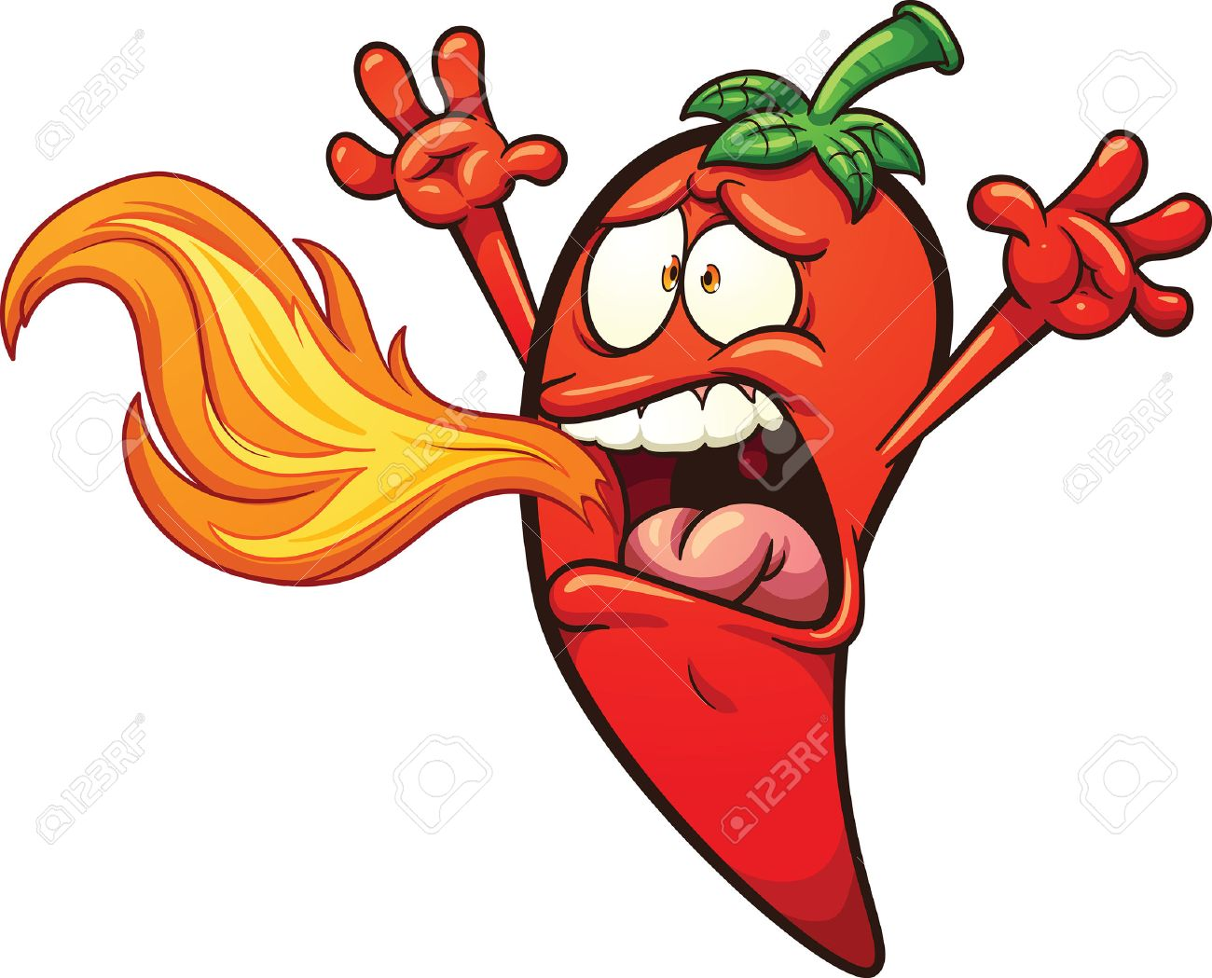

Scientific Techniques
When archaeologists and historians find objects from the past, they often need help from scientists who use the latest techniques and machinery to gather more information.
Many of these can be used to assess the age of a source.
Being able to date evidence allows historians to place events and human behaviour in time order, and make links between groups of people.
Use the information on page 204-206 of the textbook to make notes on:
Stratigraphy
Fluorine Dating
Radiocarbon Dating
Dendrochronology
DNA Analysis
Ice-Core Sampling
Palynology

Slide 22
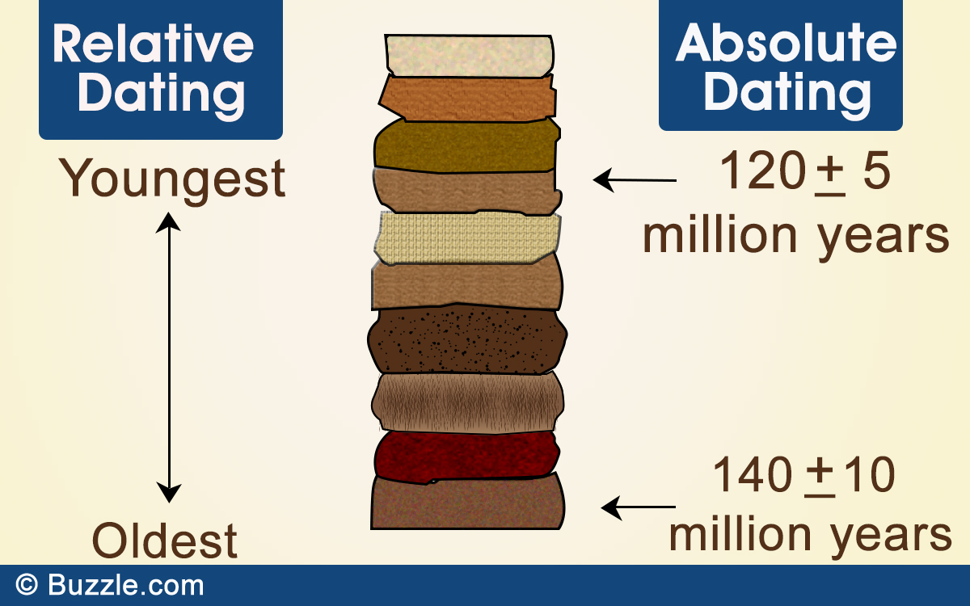
How to date an artefact
Relative Dating | Absolute Dating
When you can determine whether an object is of an earlier or more recent date relative to (compared with) another object. | When you determine the age of an object as precisely as possible (in years). They are usually combined with relative dating techniques.

Slide 23
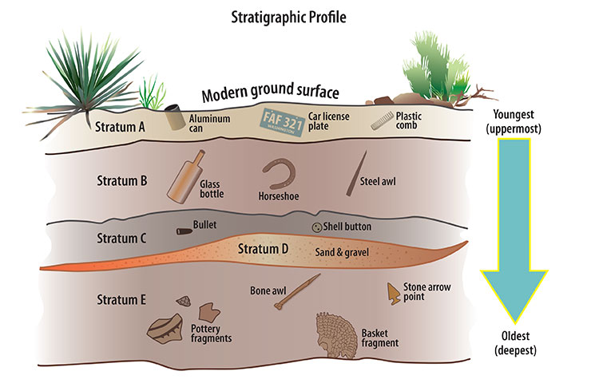
Stratigraphy
Relative Dating
Looking at sources found in the different layers (strata) of the earth.
Layers on top are youngest, layers on the bottom are oldest
Items found in a layer which is 1000 years old is probably around 1000 years old.

Slide 24
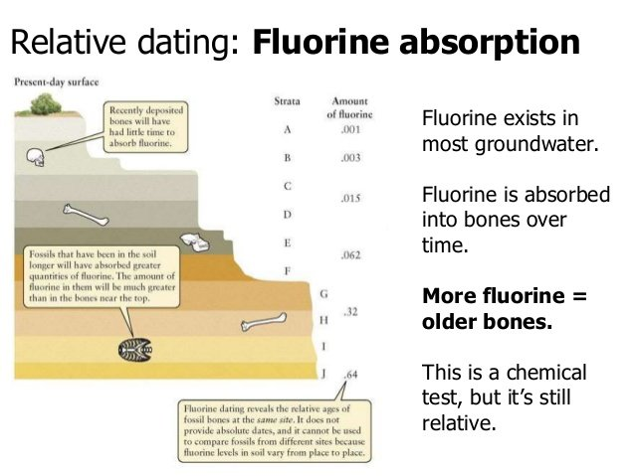
Flourine Dating
Relative Dating
A way to date bones
Bones absorb fluorine from the soil
The longer they are there, the more fluorine they absorb from the soil.

Slide 25
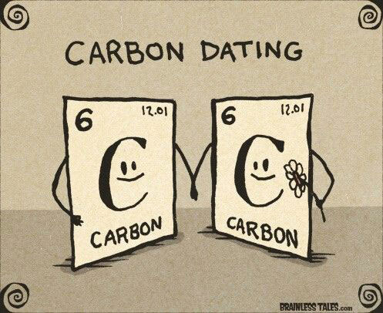
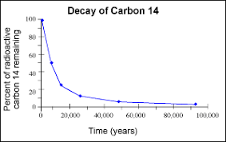
Radiocarbon Dating
Absolute Dating
All living things absorb Carbon-14, which is a radioactive form of carbon.
Living things stop absorbing C14 when they die.
Over time, C14 breaks down/decays. Scientists know the rate at which it breaks down. The less C14, the longer the organism has been dead.
Scientists use this to work out how long ago the organism died.

Slide 26
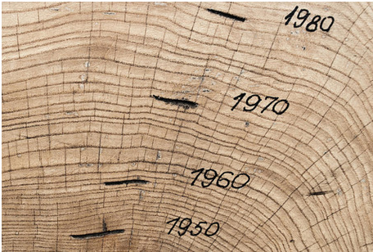
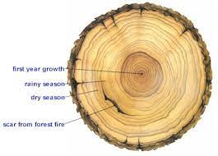
Dendrochronology (Tree Rings)
Absolute dating technique
This method dates wooden objects or trees by counting the growth rings, which represent a year’s growth.
The age of a tree is worked out by counting the number of rings in the wood.
The width and shape of each ring depend on environmental conditions such as rainfall and soil type.
Sometimes the age of wooden items (such as spear handles) can be worked out by matching the growth rings in the wood with those in a dated same from trees in the same area, as long as they are the same species.

Slide 28
Video
https://www.youtube.com/watch?v=-etaxcuJSyo

Slide 29
Question
Imagine you are an archaeologist. Briefly explain why your job is important to the study of history.

